Slide 1
Chapter 13
The Forest Fires case study

Slide 2
Objectives
Applied
Given the code in any cell or group of cells in the Forest Fires case study, describe what it does.
Knowledge
Describe the use of the GeoPandas module.

Slide 3
Get the data (part 1)
Download the zip file to disk
fires_url = \
'https://www.fs.usda.gov/rds/archive/products/RDS-2013-0009.4/'
filename = 'RDS-2013-0009.4_SQLITE.zip'
from urllib import request
request.urlretrieve(fires_url+filename, filename=filename)
Unzip and print the file info
from zipfile import ZipFile
with ZipFile(filename, mode='r') as zip:
zip.extractall()
for file in zip.infolist():
print(file.filename, file.compress_size, file.file_size)
================================================================
Data/FPA_FOD_20170508.sqlite 173776108 795785216
Data/ 0 0
_metadata_RDS-2013-0009.4.xml 11571 51400
Supplements/FPA_FOD_Source_List.pdf 74137 109336
Supplements/ 0 0
_fileindex_RDS-2013-0009.4.html 1098 4398
_metadata_RDS-2013-0009.4.html 13296 89005

Slide 4
Get the data (part 2)
Connect to the SQLite database and create a cursor
import sqlite3
fires_con = sqlite3.connect('Data/FPA_FOD_20170508.sqlite')
fires_cur = fires_con.cursor()
Check out the tables and then the columns in the Fires table
fires_cur.execute(
'SELECT name FROM sqlite_master WHERE type="table"').fetchall()
fires_cur.execute('PRAGMA table_info(Fires)').fetchall()
Import the data into a DataFrame
fires_sql = """
SELECT fire_name, fire_size,
state, latitude, longitude, fire_year,
DATETIME(discovery_date) AS discovery_date,
DATETIME(cont_date) AS contain_date
FROM Fires
"""
fires = pd.read_sql_query(fires_sql, fires_con)

Slide 5
Get the data (part 3)
Save the DataFrame
fires.to_pickle('fires_raw.pkl')

Slide 6
Examine the data with the info() method
fires.info(memory_usage='deep')
==========================================
<class 'pandas.core.frame.DataFrame'>
RangeIndex: 1880465 entries, 0 to 1880464
Data columns (total 8 columns):
FIRE_NAME 923276 non-null object
FIRE_SIZE 1880465 non-null float64
STATE 1880465 non-null object
LATITUDE 1880465 non-null float64
LONGITUDE 1880465 non-null float64
FIRE_YEAR 1880465 non-null int64
discovery_date 1880465 non-null object
contain_date 988934 non-null object
dtypes: float64(3), int64(1), object(4)
memory usage: 473.8 MB

Slide 7
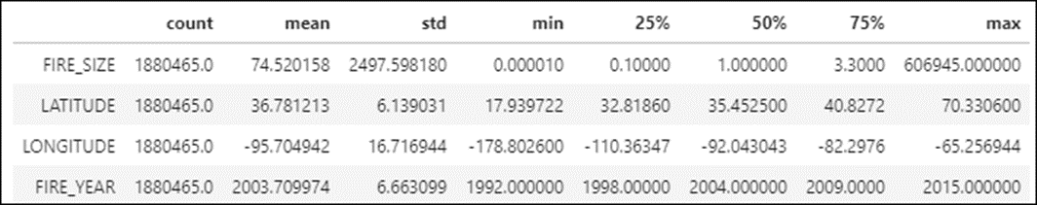
Examine the data with the describe() method
fires.describe().T

Slide 8
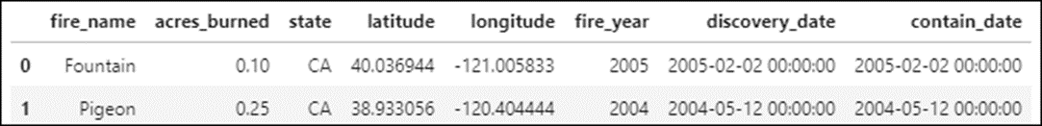
Improve the readability of the data
Make the column names lowercase
fires.columns = fires.columns.str.lower()
fires.head(2)
Rename the fire_size column
fires.rename(columns={'fire_size':'acres_burned'},
inplace=True)
Convert the data in the fire_name column to title case
fires['fire_name'] = fires.fire_name.str.title()

Slide 9
Drop unnecessary rows
Drop the rows for fires that are less than 10 acres
fires = fires[fires.acres_burned >= 10]
Check DataFrame info
fires.info(memory_usage='deep')
=============================================
Int64Index: 274170 entries, 16 to 1880441
Data columns (total 8 columns):
# Column Non-Null Count Dtype
--- ------ -------------- -----
0 fire_name 128667 non-null object
1 acres_burned 274170 non-null float64
2 state 274170 non-null object
3 latitude 274170 non-null float64
4 longitude 274170 non-null float64
5 fire_year 274170 non-null int64
6 discovery_date 274170 non-null object
7 contain_date 137377 non-null object
dtypes: float64(3), int64(1), object(4)
memory usage: 70.6 MB

Slide 10
Drop duplicate rows
See if there are any duplicate rows (this returns 94 rows)
fires[fires.duplicated(keep=False)]
Drop the duplicates but keep the first duplicate in each set
fires = fires.drop_duplicates(keep='first')

Slide 11
Convert dates to datetime objects
fires.discovery_date = pd.to_datetime(
fires.discovery_date, infer_datetime_format=True)
fires.contain_date = pd.to_datetime(
fires.contain_date, infer_datetime_format=True)

Slide 12
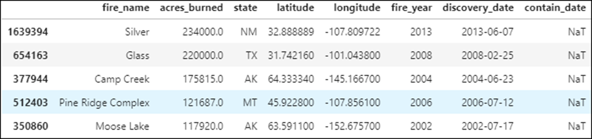
Check for missing contain dates
In all rows
fires[fires.contain_date.isnull()] # returns 136,747 rows
In rows for fires greater than or equal to 10,000 acres and sort them
fires.query('contain_date == "NaT" & acres_burned >= 10000') \
.sort_values('acres_burned', ascending=False)

Slide 13
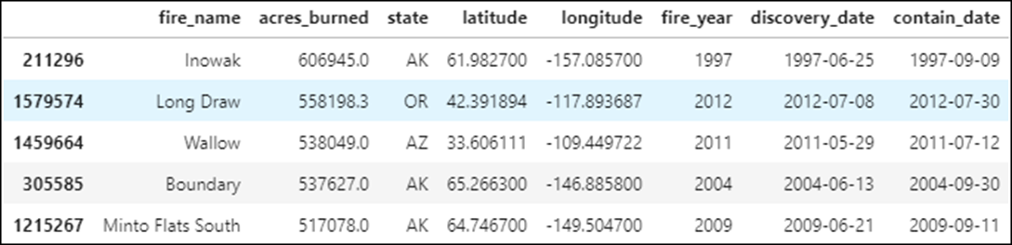
Check for missing contain dates (continued)
Analyze the rows that do have contain dates
fires.query('contain_date != "NaT" & acres_burned >= 100') \
.sort_values('acres_burned', ascending=False)

Slide 14
Four ways to handle the missing values
Don’t consider the contain dates in your analysis because the data is incomplete.
If you’re going to include the contain dates in your analysis, only analyze the rows that have contain dates.
Based on the contain dates in the rows that do have them, calculate appropriate values for the contain dates in the rows that have missing values.
Defer this decision until you prepare or analyze the data. As you do that, you’ll get a better idea of whether the contain dates are important to your analysis.

Slide 15
Save the cleaned DataFrame
fires.to_pickle('fires_clean.pkl')

Slide 16
Add fire_month and days_burning columns
fires['fire_month'] = fires.discovery_date.dt.month
fires['days_burning'] = (fires.contain_date - fires.discovery_date).dt.days

Slide 17
Examine the data in the days_burning column
fires.days_burning.describe()
=============================
count 137376.000000
mean 3.254520
std 16.052833
min 0.000000
25% 0.000000
50% 0.000000
75% 1.000000
max 1881.000000
Name: days_burning, dtype: float64

Slide 18
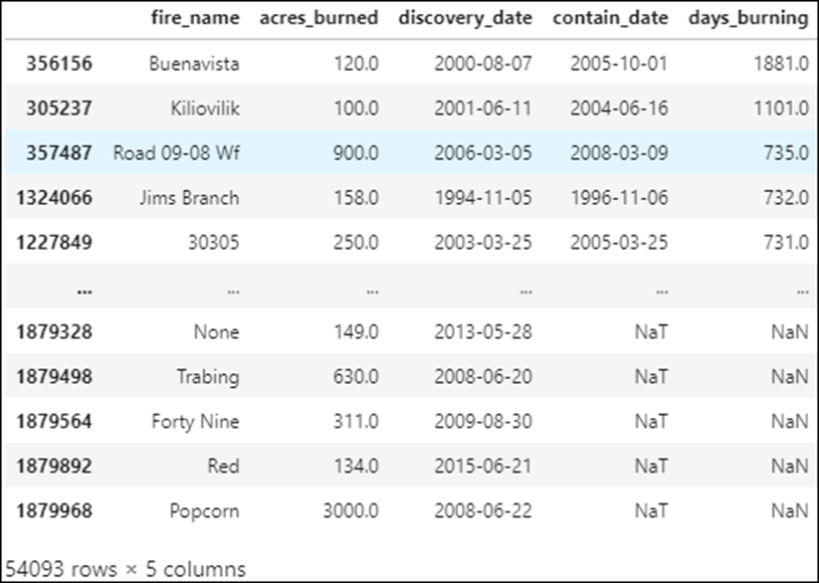
Take a closer look at the data for fires greater than or equal to 100 acres
fires.query('acres_burned >= 100')[['fire_name','acres_burned', \
'discovery_date','contain_date','days_burning']] \
.sort_values('days_burning', ascending=False)

Slide 19
Save the prepared DataFrame
fires.to_pickle('fires_prepared.pkl')

Slide 20
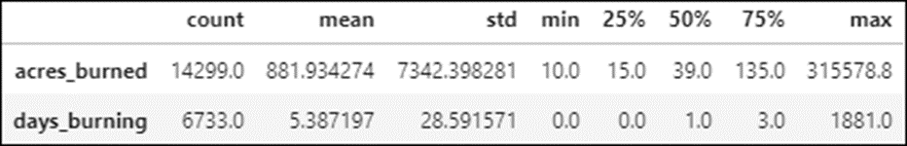
Analyze the data for California (part 1)
Get the statistics
fires.query(
'state == "CA"')[['acres_burned','days_burning']].describe().T

Slide 21
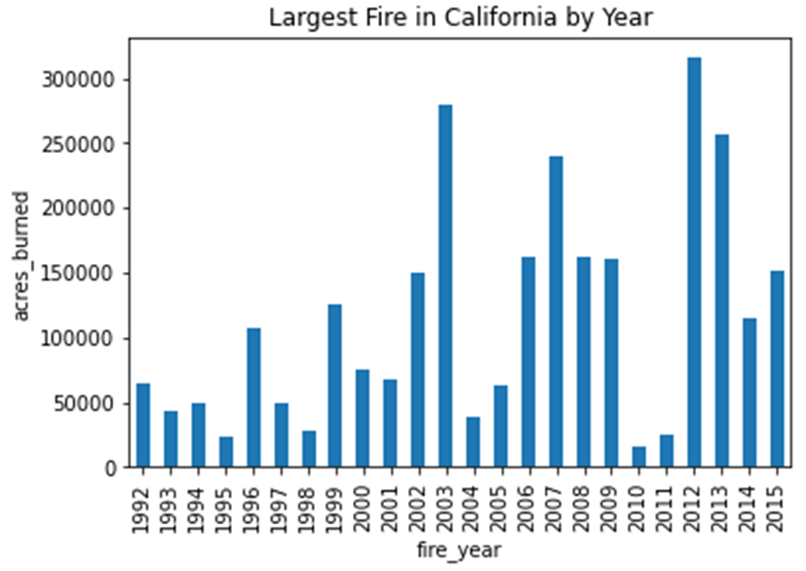
Analyze the data for California (part 2)
Plot the maximum fire size by year
fires.query('state == "CA"') \
.groupby('fire_year').acres_burned.max() \
.plot.bar(ylabel='acres_burned',
title='Largest Fire in California by Year')

Slide 22
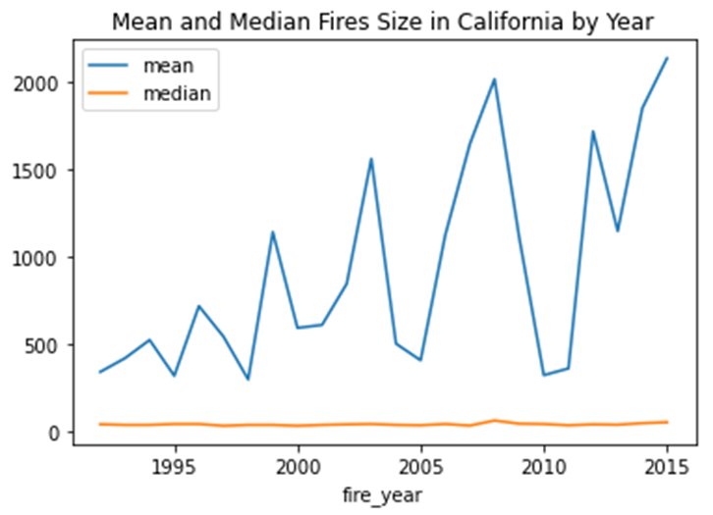
Analyze the data for California (part 3)
Plot the mean and median fire size by year
fires.query('state == "CA"') \
.groupby('fire_year').acres_burned.agg(['mean','median']) \
.plot(title='Mean and Median Fires Sizes in California by Year')

Slide 23
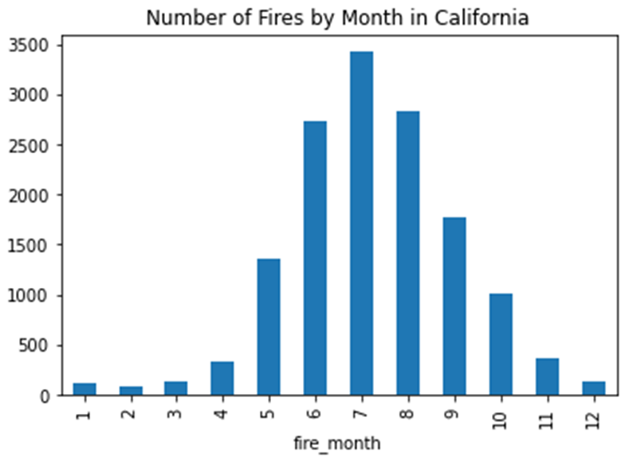
Plot the California fire count by month
fires.query('state == "CA"') \
.groupby('fire_month').acres_burned.count() \
.plot.bar(title='Number of Fires by Month in California')

Slide 24
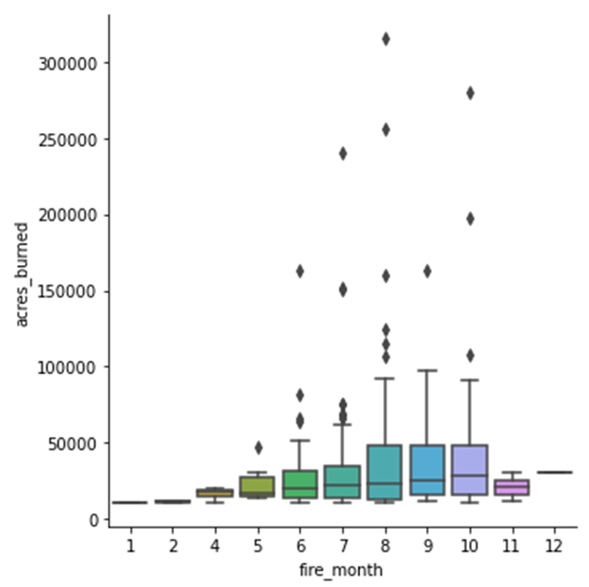
Use Seaborn to create a box plot for California fires over 10,000 acres by month
import seaborn as sns
sns.catplot(data=fires.query('state == "CA" & acres_burned >= 10000'),
kind='box', x='fire_month', y='acres_burned')

Slide 25
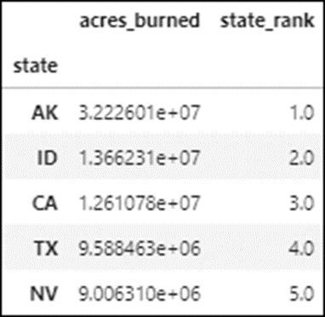
Rank the states by total acres burned
Get the sum of the fire sizes for each state
fires_states = fires.groupby('state').acres_burned.sum().to_frame()
Add the rank for each state based on its total fire acres and sort by rank
fires_states['state_rank'] = \
fires_states['acres_burned'].rank(ascending=False)
fires_states.sort_values('state_rank', inplace=True)
fires_states.head()

Slide 26
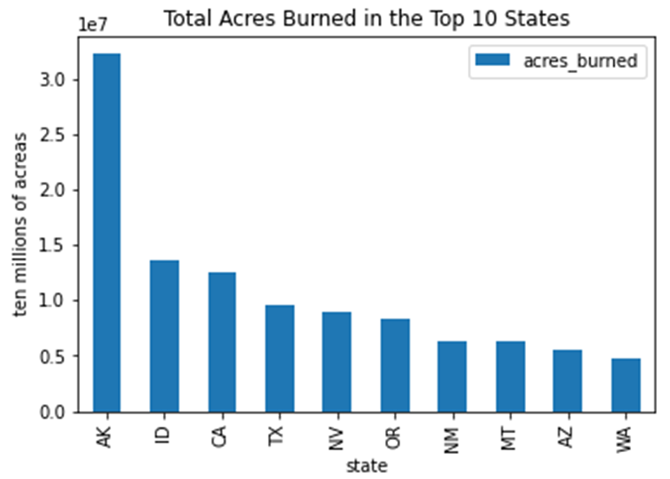
Rank the states by total acres burned (continued)
Plot the total fire acres for the top 10 states
fires_states.query('state_rank <= 10') \
.plot.bar(y='acres_burned', ylabel='ten millions of acreas',
title='Total Acres Burned in the Top 10 States')

Slide 27
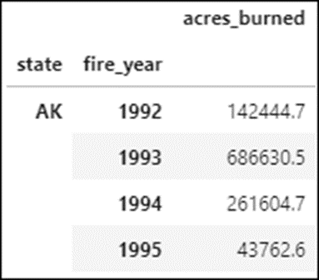
Prepare a DataFrame for total acres burned by year within state
Get the fire sums by year within each state
fires_states_years = fires.groupby(
['state','fire_year']).acres_burned.sum().to_frame()
fires_states_years.head(4)

Slide 28
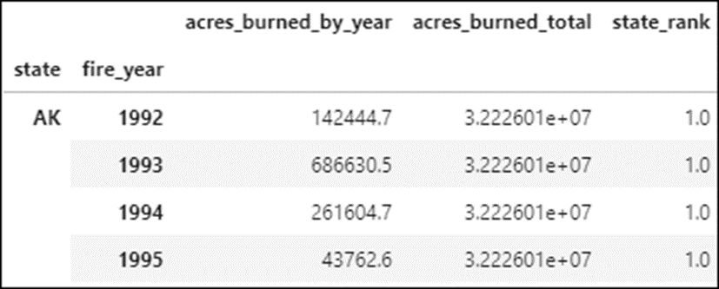
Prepare a DataFrame for total acres burned by year within state (continued)
Join the fires_states_years and the fires_states DataFrames
fires_states_years = fires_states_years.join(fires_states,
lsuffix='_by_year', rsuffix='_total')
fires_states_years.head(4)

Slide 29
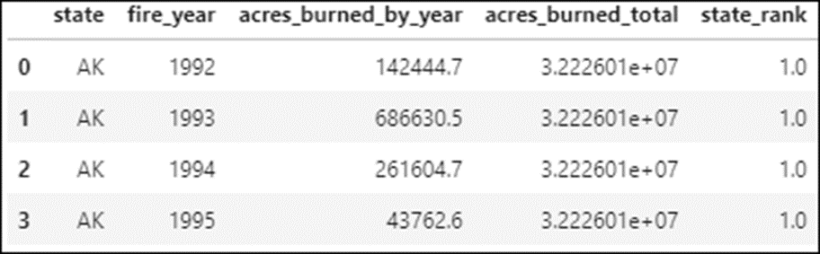
Prepare a DataFrame for the top 4 states
fires_states_top4 = \
fires_states_years.query('state_rank <= 4')
fires_states_top4 = fires_states_top4.reset_index()
fires_states_top4.head(4)

Slide 30
Plot the acres burned total by year for the top 4 states
g = sns.relplot(data=fires_states_top4, kind='line',
x='fire_year', y='acres_burned_by_year', hue='state',
col='state', col_wrap=2, legend=False)
g.fig.suptitle('Total Acres Burned by Year in the Top 4 States',
y=1.025)
for ax in g.axes.flat:
ax.set_xlabel('Fire Year')
ax.set_ylabel('Millions of Acres')

Slide 31
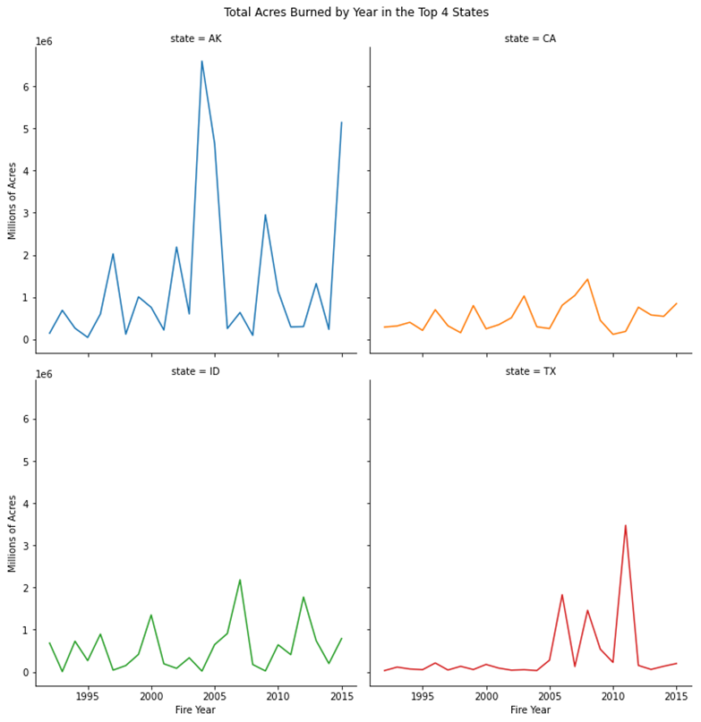
Plot the acres burned total by year (continued)

Slide 32
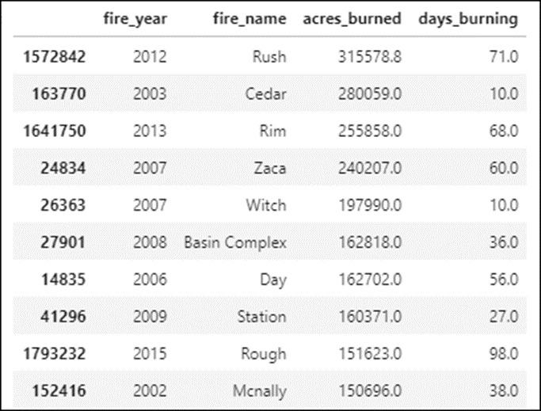
Review the 20 largest fires in California
List the fires
top_fires = fires.query('state == "CA"').nlargest(20, columns='acres_burned')
top_fires.sort_values('acres_burned', ascending=False)
top_fires[['fire_year','fire_name','acres_burned',
'days_burning']].head(10)

Slide 33
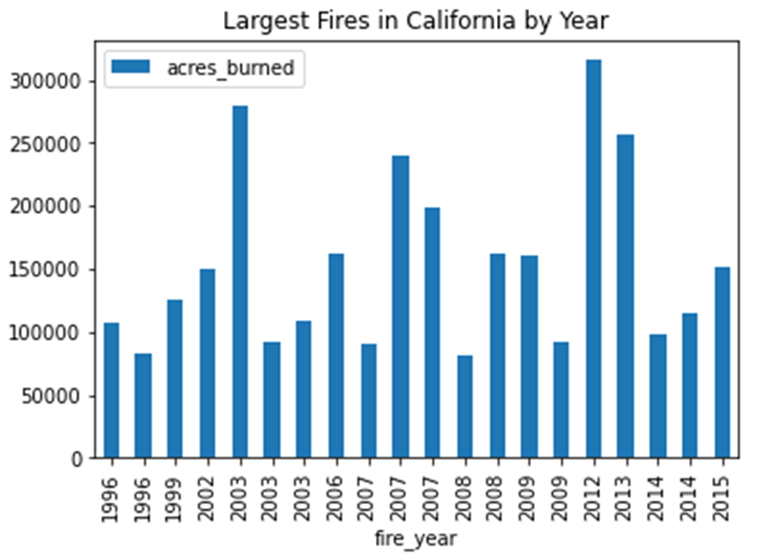
Review the 20 largest fires in California (cont.)
Plot the fires
top_fires.sort_values('fire_year').plot.bar(
x='fire_year', y='acres_burned',
title='Largest Fires in California by Year')

Slide 34
Create a GeoDataFrame for the California fires
Create a DataFrame for the California fires in 2015
fires_CA_2015 = fires.query( \
'fire_year == 2015 & state == "CA"')
Create a GeoDataFrame for those fires
import geopandas as geo
fire_locations = geo.GeoDataFrame(fires_CA_2015,
geometry=geo.points_from_xy(fires_CA_2015.longitude,
fires_CA_2015.latitude))

Slide 35
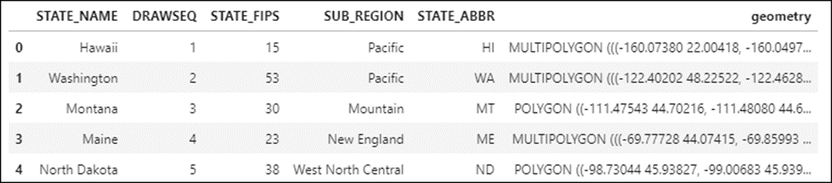
Get a California map from Geopandas
Create a GeoDataFrame for the maps of the United States
usa = geo.read_file('Maps/states.shp')
usa.head()
Create a GeoDataFrame for the map of California
ca_map = usa[usa.STATE_ABBR == 'CA']

Slide 36
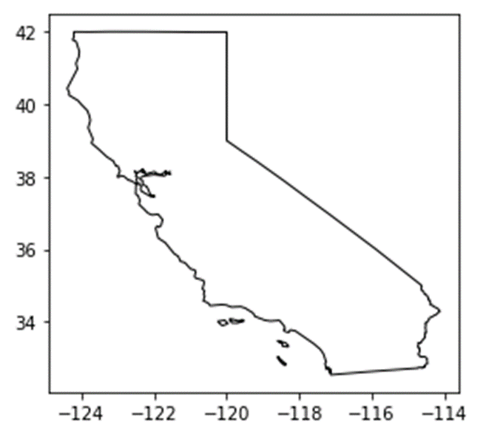
Use Geopandas to plot the California map
ca_map.plot(color='white', edgecolor='black')

Slide 37
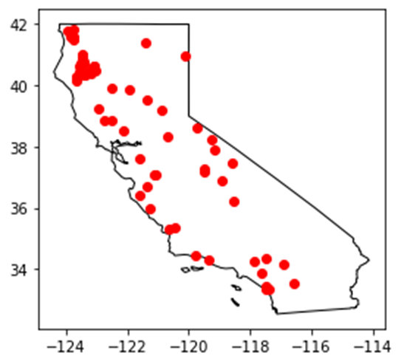
Use Geopandas to plot the California fires over 500 acres on a map
fire_locations.query('acres_burned > 500').plot(color='red',
ax=ca_map.plot(color='white', edgecolor='black'))

Slide 38
Plot the California fires over 500 acres
Use Geopandas to plot the map of California
ca_map = usa[usa.STATE_ABBR == 'CA']
ca_map.plot(color='white', edgecolor='black')

Slide 39
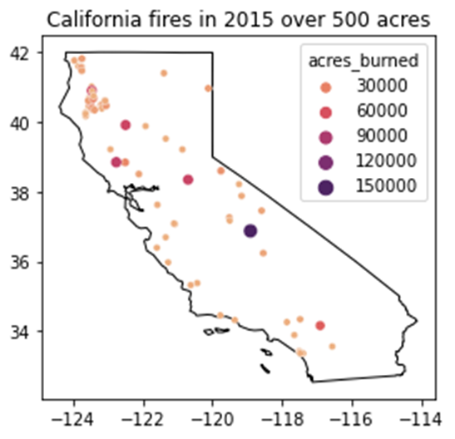
Plot the California fires over 500 acres (cont.)
Use Seaborn to plot the fires on the map
ax = sns.scatterplot(data=fires_CA_2015.query('acres_burned > 500'),
x='longitude', y='latitude', size='acres_burned',
hue='acres_burned', palette='flare')
ax.set(title='California fires in 2015 over 500 acres',
ylabel=None, xlabel=None)

Slide 40
Plot the fires in the continental U.S.
Create a GeoDataFrame for the map and plot it
continental_usa = usa.loc[1:49]
continental_usa.plot(color='white', edgecolor='black')

Slide 41
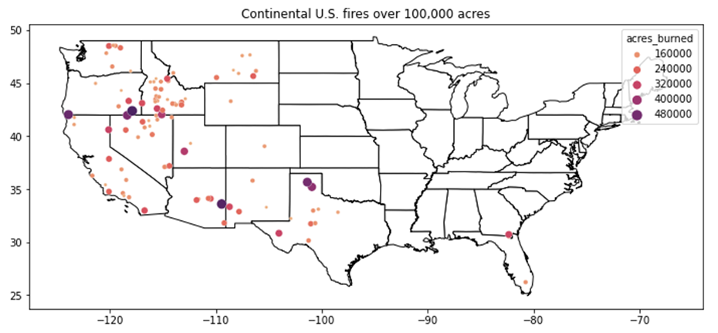
Plot the fires in the continental U.S. (continued)
Use Seaborn to plot the fires over 100,000 acres on the map
ax = sns.scatterplot(data=fires.query(
'acres_burned > 100_000 & state not in ["AK","HI"]'),
x='longitude', y='latitude', size='acres_burned', sizes=(10,100),
hue='acres_burned', figsize=(12,5))
ax.set(title='Continental U.S. fires over 100,000 acres',
ylabel=None, xlabel=None)

Slide 42
Save the plot to a PNG file
ax.get_figure().savefig('us_fires_map.png')

